Slide 1
Elementary Social Studies Forum 2014-2015
Theresa Gray
Marcy Sweetman

Slide 2
Welcome!
Norms of Collaboration
Introductions
Purpose of Forum

Slide 3
Introductory Video

Slide 4
2012-2013: Draft Framework reviewed by field
-November 1-2, 2013: Content Advisory Panel
reviewed second draft.
-Revised and edited draft based on feedback
-December 2013: Second draft released for public commentary
-January 2014: Content Advisory Panel reconvened to review public commentary
- Final revisions…finished
-March 10, 2014: Presentation to Board of Regents

Slide 5
Field Guide: coming early fall
Assessments and Regulations: CAP Recommendation:
2 year mandated Global History and Geography*
10th grade Regents exam (only 10th grade content)
*pending Board approval
Resources: NYS K-12 Social Studies Resource Toolkit
Created by NYS Teachers for NYS Teachers
Aligned to NCSS C3 Framework

Slide 6
Same 5 NYS Social Studies Learning Standards
Standard 1: History of the United States and New York
Standard 2: World History
Standard 3: Geography
Standard 4: Economics
Standard 5: Civics, Citizenship, and Government

Slide 7
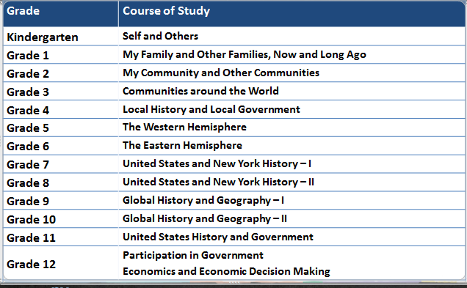
Course of study remains the same!
Notes:
JOHN:
The course of study and the topics for each grade remain the same; we are taking a new approach to the content within each grade to align it more to the demands of the Common Core. There have been very limited changes to the course titles: Grade 2 dropped US communities, Grade 3 dropped the subtitle: People and Places learning, Grade 5 had identified specifically the United States, Canada and Latin America; for better alignment it is now referred to as The Western Hemisphere

Slide 8
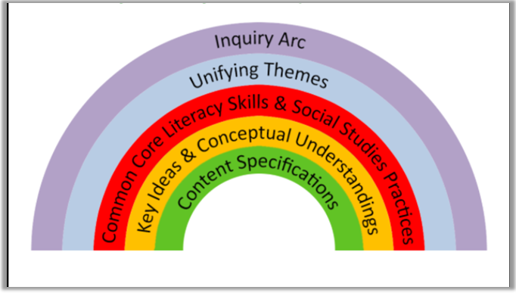
A Program that Supports Teaching, Learning and Assessment
Notes:
GREG:
Using the Inquiry Arc as a model for instructional change, the Framework specifically intends to see this instructional change by integrating:
Key ideas/conceptual understandings with the supporting content specifications AND
Common Core Literacy Skills with
Social Studies Practices

Slide 9
The Foundation:Key Ideas, Conceptual Understandings & Content Specifications
Notes:
JOHN:
Relationship of content and structure of this work.

Slide 10
How to Read the Framework
Notes:
JOHN:
Key ideas—the central organizing feature for each grade—
represent the essential and enduring content understandings that should be the focus of teaching and learning for each grade.
Conceptual Understandings—more specific statements that support the key idea
Content specifications—identify particular social studies content that helps to illuminate the conceptual understandings, providing examples within the context of “student will” statements in order to suggest broad instructional activities.

Slide 11
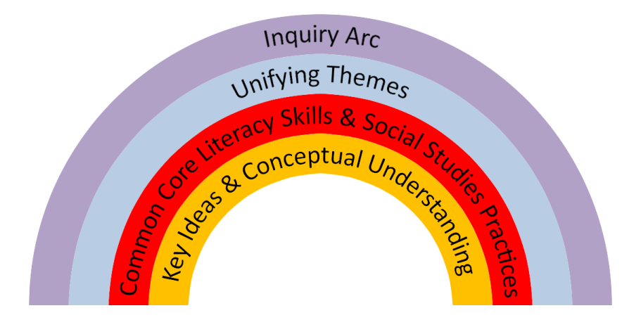
Social Studies Practices
1. Gathering, Using, and Interpreting Evidence
2. Chronological Reasoning and Causation
3. Comparison and Contextualization
4. Geographic Reasoning
5. Economics and Economics Systems
6. Civic Participation
Notes:
GREG:
SOCIAL SCIENCE AND HISTORICAL THINKING SKILLS!!!!!!!!!!!!!!!!!!!! … Practices and Common Core BUILD SKILL….part of same red band on arc.
The Social Studies Practices represent the social science and historical thinking skills that students should develop throughout their K-12 education in order to be prepared for civic participation, college, and careers. Similar to the Mathematical Practices within the Common Core Learning Standards, the Social Studies Practices should be infused with the Social Studies content contained within the Key Ideas and Conceptual Understandings. The Practices were created based on the existing New York State Social Studies Learning Standards, the National Geography Standards, the historical thinking skills articulated within the new Advanced Placement World History Curriculum Framework, the National Council for the Social Studies Standards, and the Habits of the Mind published by the National Council for History Education.

Slide 12
Common Core Skills
Reading
Key Ideas and Details
Craft and Structure
Integration of Knowledge & Ideas
Range of Reading & Text Complexity
Writing
Text Types and Purposes
Production and Distribution of Writing
Research to Build and Present Knowledge
Range of Writing
Speaking and Listening
Comprehension and Collaboration
Presentation of Knowledge and Ideas
Notes:
GREG:
The Framework imbeds the Common Core Skills for each grade level K-8, and for 9-10 and 11-12. These align closely to the Common Core Learning Standards.
Note: HISTORICAL CONTEXT AS AN ESSENTIAL ELEMENT TO READING A TEXT……INTEGRATING SKILL AND CONTENT

Slide 13
Notes:
Published by the National Council for the Social Studies in September 2014, this work was reviewed and elements of it were added to the framework.

Slide 14
INQUIRY
ARC
DISCIPLINARY
LITERACY
CIVIC
LIFE
C3 Foundations
Notes:
C3 Framework built around three pillars:
An Inquiry Arc that provides the backbone to the document as well as the binding mechanism for the social studies disciplines of civics, economics, geography and history
Disciplinary Literacy: With the advent and adoption of the Common Core, it has been made clear that social studies shares in the responsibility of literacy education of K-12 students.
Civic Life: In social studies, we recognize the importance of preparing students for College and Career—we believe social studies contributes to this mission. Additionally, though, we believe that public schools also have a responsibility to train our youngest citizens for democratic life—and that social studies has a unique responsibility in the mission and we have chosen to elevate this mission along side College and Career as an outcome to this significant document.

Slide 15
Inquiry Arc
Dimension 1: Developing Questions and Planning Inquiries
Dimension 2: Applying Disciplinary Tools and Concepts (Civics, Economics, Geography, and History)
Dimension 3: Evaluating Sources and Using Evidence
Dimension 4: Communicating Conclusions and Taking Informed Action
C3 Inquiry Arc
What is the C3 Framework?
Notes:
GREG:
The dimensions of the Inquiry Arc as presented in the C3 Framework are:
Developing Questions and Planning Inquiries
Applying Disciplinary Tools and Concepts
Evaluating Sources and Using Evidence
Communicating Conclusion and Taking Informed Action

Slide 16
SHIFTS AS DEFINED BY NYSED
Focus on Conceptual Understandings Increased emphasis on patterns, themes and concepts that cut across place and time. Decreased emphasis on rote memorization.
Evidence-based Argumentation
Students learn to utilize primary and secondary sources by placing them in context, gathering information and evidence in order to formulate a coherent argument.
Dual Intensity
Students focus on both content and skills as outlined by the Social Studies Practices and Common Core Learning
Standards.

Slide 17
Instructional Shift #1: Focus on Conceptual Understanding
From
To
Facts
Concepts and Content Knowledge
????
Breadth of Topics
Depth within Topics
????
Recall
????
Transfer and Connections

Slide 18
Instructional Shift #2: Foster Student Inquiry, Collaboration, and Informed Action
From
To
Teacher as Disseminator
????
Teacher as Facilitator of Investigation
Students Learn Facts from Textbook
????
Students Investigate the Social Sciences Using Multiple Sources
Students Retell Interpretations
????
Students Construct Interpretations and Communicate Conclusions

Slide 19
Instructional Shift #3: Integrate Content and Skills Purposefully
FROM A Social Studies Classroom Where… | TO A Social Studies Classroom Where…
Students experience an additional nonfiction reading class or textbook focused instruction | Students learn to read, discuss, and write like social scientists
Students develop literacy skills and social studies practices separately | Students develop disciplinary literacy skills and social science practices in tandem
Students learn content knowledge | Students integrate and apply concepts, skills, and content knowledge
????
????
????

Slide 20
Standards are a start, but….
The new New York Social Studies Framework is more reasonably expressed than the previous one….
But still too much!

Slide 21
For Example….
11.1b (point 3) “Students will analyze slavery as a deeply established component of the colonial economic system and social structure, indentured servitude v. slavery, the increased concentration of slaves in the South, and the development of slavery as a racial institution”


Slide 22
And the C3 Framework is a lot too…
D2.His.2.9-12. Analyze change and continuity in historical eras.

Slide 23
Task of the Resource Toolkit and Professional Development Project
To marry the global vision of the C3 Framework to the content specifics of the NYS Framework in a way that honors, supports, and extends teachers’ and students’ best classroom ambitions.

Slide 24
Tricky Work...
Social studies plagued by too much content
Social studies standards rarely translated into useable curriculum and almost never supported by state-level assessments
Social studies instruction dominated by a view that we have to teach every person, place, and event before we ask students to make sense of it.
We get frustrated…students get frustrated…and social studies withers….

Slide 25
The heart of the the C3 Framework—Jerome Bruner
“We begin with the hypothesis that any subject can be taught effectively in some intellectually honest form to any child at any stage of development”—The Process of Education

Slide 26
The heart of the C3 framework--The Inquiry Arc

Dimension 1: Developing Questions and Planning Inquiries
Dimension 2: Applying Disciplinary Concepts and Tools (Civics, Economics, Geography, and History)
Dimension 3: Evaluating Sources and Using Evidence
Dimension 4: Communicating Conclusions and Taking Action

Slide 27
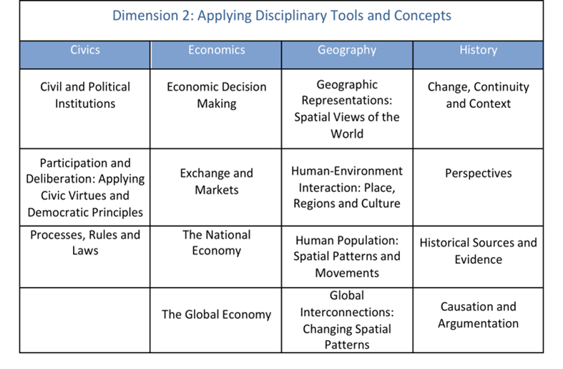
Dimension 2: Applying disciplinary tools and concepts

Slide 28
The New York State K-12 Social Studies
Resource Toolkit and Professional Development Project
What…and When
Curriculum Development—14 Annotated Inquiries and 70 Abridged Inquiries/July 2014-August, 2015

Piloting—September 2014-March 2015

Professional Development—District, State-Level, and National/July 2014-August 2015

Assessment—Assistance with design of new Regents exams/Spring 2015-Spring 2018/19

Slide 29
The New York State K-12 Social Studies
Resource Toolkit and Professional Development Project
Why…
Because the Common Core-ELA is necessary, but not sufficient
Because translating standards into practice is challenging work
And because we need a new paradigm for teaching and learning social studies

Slide 30
Compelling questions
Intellectually meaty
Kid friendly

Slide 31
Intellectually meaty
Reflects an enduring issue, concern, or debate in the field
Demands the use of multiple disciplinary lenses and perspectives

Slide 32
Kid friendly
Reflects a quality or condition that we know children care about
Honors and respects children’s intellectual efforts

Slide 33
Compelling…or not so compelling?
Where are we?
What were the causes of the Industrial Revolution?
Why is Albany the capital of New York?
Can Canada and the US be friends forever?
Who won the Cold War?
Who are our community helpers?
What’s the deal with hair?

Slide 34
A sample toolkit inquiry:
Does where you live matter?

Slide 36
Toolkit inquiries
By summer 2014, writers will produce:
14 annotated inquiries (1 per grade level K-11; 2 at grade 12)
70 abridged inquiries (5 per grade level K-11; 10 at grade 12)

All will be available on-line through EngageNY

Slide 37
Let’s try…...

Slide 38
The Gettysburg Address
What do you know about the Gettysburg Address?
What questions do you have about it?
What do you think was the reaction to the Gettysburg Address at the time?
Think - Write- Pair - Share

Slide 39
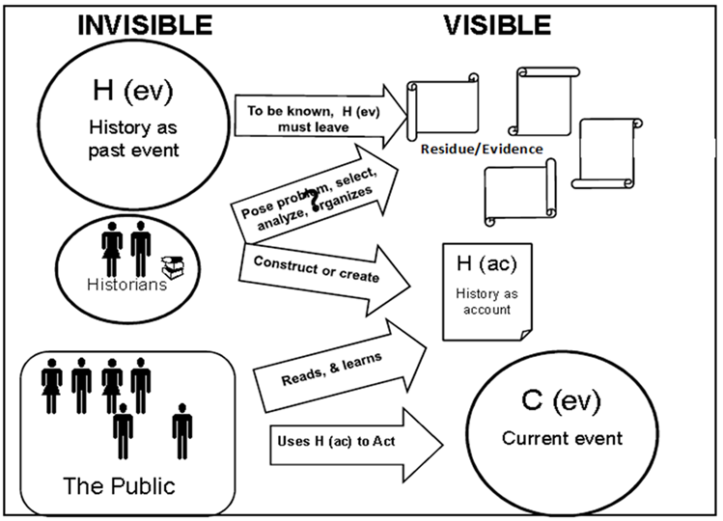
How History Works

Slide 40
How History Works
History is interpretive.
History is contested and contestable.
History is an argument in favor of a particular narrative based on evidence.
Some events or issues are more significant than others

Slide 41
History is contested and contestable.
We contest it through reading and writing, speaking and listening.

Slide 42
How does time change history?

Slide 43
With a partner:
•Read the speech (what is your reaction?)
•Read through the comments and reactions and decide:
–What does each reviewer think about the speech? What is your evidence?
–What factors might account for any differences of opinion?

Slide 44
Some guiding questions...
•How did people living at the time think about what President Lincoln said at Gettysburg?
•Are these reactions similar or different to today’s opinions about the speech and Lincoln’s ideas about democracy, government and community?
•Have American's views of their democracy, government and community changed over time?
•Does it make a difference?

Slide 45
How does time change history?

Slide 46
Design Time

Slide 47
WHAT IF YOU HAD ONE AFTERNOON TO LEARN/CREATE/EXPLORE AROUND ANY TOPIC YOU COULD USE IN YOUR CLASSROOM?

Slide 48
Combination of TWO ideas
“Fed Ex Days”
•Small bursts of autonomy
•Absolutely, positively must deliver overnight
“Genius Hour”
•“Non-Commissioned work”
•60 minutes to work on new ideas or master new skills

Slide 49
Why?

Slide 51
To Consider…...
•Task – Choose tasks that will benefit and impact student learning. Think differently!
•Technique – Design your activities and project work in your own way, so long as the end result is a benefit to students.
•Team – Work with anyone you want to work with. Consult with the many knowledgeable people in our groupl! Individuals that choose not to collaborate will still be responsible for “delivering.” Consider the importance of the collaborative efforts!
•Time – Use your time as you see fit. But use it wisely – it is limited in this space!
•Transparency – You must “deliver” your product to the larger group at the end of the day.

